Slide 1
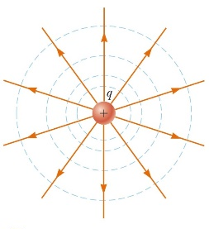
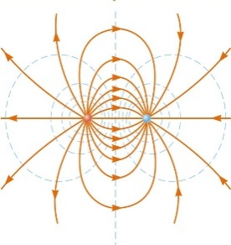
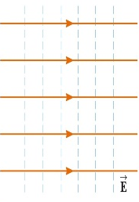
Chapter 25: Electric Potential
Reading assignment: Chapter 25
HW. 25.1 (due Monday, Feb. 11): CQ2, 1, 2, 3,
HW. 25.2 (due Wednesday, Feb. 13): OQ2, OQ5, OQ7, OQ9, 4, 7, 12, 14, 19, 27
HW 25.3 (due Monday, Feb. 22): OQ3, 37, 39, 50, 69
Concept of energy is very valuable:
Energy is conserved (one of the fundamental principles of physics).
Many problems can be solved using energy without having knowledge of the involved forces.
Energy is a scalar, force is vector (scalar is easier).
Electric potential, V, and electric potential energy U = q ∙V of different charge arrangements.
Electric potential, V, is a very important quantity in electricity.
It is also possible to calculate the electric field from the electric potential; $\vec{E}=−\vec{∇}V$.
→ equipotential lines are perpendicular to electric field lines.
(Millikan oil drop experiment.)
Initially we will look at a uniform, constant field
(good to understand concept)
Then at a point charge
Then at more general fields

Slide 2
Announcements:
Midterm 1: Friday, Feb. 15; (two evening times, 4:00 – 5:00 pm or 5:00 – 6:00 pm), room Olin 101.
Material: Chapters 23 – 25 (through HW 25.2).
Review session Friday, Feb. 15, in-class.
I’ll provide key equations (last page of exam).
You are allowed to use a non-programmable calculator.

Slide 3
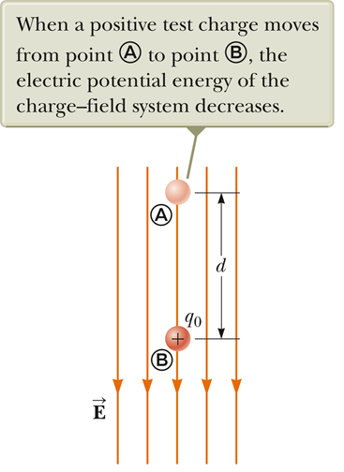
Work & Electric potential energy
(simplest case: E is constant, field between two plates))
Electric force is a conservative force - the work/energy to move a charge does not depend on path, only on initial and final position.
Work done when moving a charge, q, a distance, s, (from A to B) in a uniform electric field, E:
Definition:
The change in electric potential energy, ΔU_{e}, when a charge q moves from some point A to point B, is the negative of the work done by the electric force to move the charge from A to B.
This is the electric potential energy when the field is straight and constant, path is straight.

Slide 4
Work and potential energy of a conservative force
Gravitational potential energy
Electric potential energy
Work, W, done by gravitational force, F_{g}, and gravitational potential energy
Work, W, done by electric force, F_{e}, and electric potential energy
$$ΔU_{e}=−qEd$$
$$ΔU_{e}=qΔV$$
$$ΔU_{g}=−mgd$$
Simple analogy for constant gravitational and electric fields

Slide 5
Electric Potential Energy
q
E
q
ds
E
s
s
When the electric field varies we need to use the integral form to calculate the electric potential energy
Notes:
Start with warmup05 q1

Slide 6
The Electric Potential
The electric potential V is defined as V = U_{e}/q:
$$ΔV=\frac{ΔU_{e}}{q}=−\int{\vec{E}}∙d\vec{s}$$
$$so: ΔU_{e}=q∙ΔV$$
Using the integral formula is a little tricky
It looks like it depends on which path you take. But it doesn’t, because of conservation of energy
Electric potential is a scalar; it doesn’t have a direction
Electric potential is so important, it has its own unit, the volt (V)
A volt is a moderate amount of electric potential
Electric field is usually given in volts/meter (previously we used Newton/Coulomb)
Notes:
Wamup05 q2 also quick quiz 3 pg 718
Potential energy stored in a system due to configuration of its parts.
Potential is property of charges/electric field defining hw much work could be done per unit charge.
Point charge by itself has potential, no potential energy. Like Force and E field.
Battery has potential.

Slide 7
Why Electric Potential is useful
It is a scalar quantity – that makes it easier to calculate and work with
It is useful for problems involving conservation of energy
White board example 25.1
An electron in the picture tube of an old TV is accelerated from rest through a potential difference V_{ba}= +5000V.
What is the change in potential energy of the electron?
What is the speed of the electron (m = 9.1·10⁻³¹ kg) as a result of this acceleration?
Repeat for a proton (m = 1.67·10⁻²⁷ kg) that accelerates through a potential difference of V_{ba}= -5000V (homework)

Slide 8
White board example 25.2
An electron moving parallel to the x-axis has an initial speed of 3.7 x 10⁶ m/s at the origin. Its speed is reduced to 1.4 x 10⁵ m/s at the point x = 2.0 cm.
Calculate the potential difference between the origin and this point.
Which point is at a higher potential?
V =0
V = ?
E
-

Slide 9
Calculating the Electric Potential, V, from the electric field, E
To find the potential at a general point B:
Pick a point A which we will assign potential 0
Pick a path from A to B
It doesn’t matter which path, so pick the simplest possible one
Perform the integration
Notes:
Do up with y = 0 have V = 0. Example consant E field. Say 5 N/C what is delta V?

Slide 10
Calculating the Electric Potential, V, from the electric field, E
Example 1: Potential from a uniform electric field E in x
Potential from a uniform electric field E in x:
V high
V low
+
-
+
-
+
-
+
-
+
-
$$V=−E∙d$$
Electric potential of uniform E-field
+
-
E
Equipotential lines are perpendicular to E-field
E-field lines point from high potential to low (from positive to negative charges)
High potential at positive charges, lower potential at negative charges
Positive charges have the most energy at high potential
Negative charges have the most energy at low potential
Notes:
Do up with y = 0 have V = 0. Example consant E field. Say 5 N/C what is delta V?

Slide 11
i-clicker
Which is true?
Electric potential is a vector quantity.
Electric field lines sometimes point in the direction of increasing potential and sometimes point in the direction of decreasing potential.
The electron volt (eV) is a unit of force.
Only difference in electric potential are meaningful – in principle, one can define the electric potential to be zero anywhere (but we usually pick a convenient point).

Slide 12
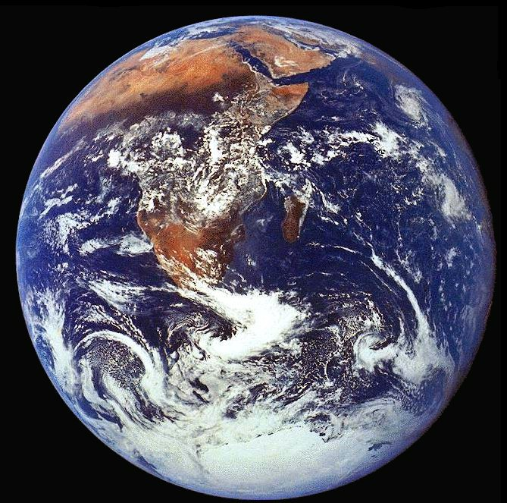
The Zero of the Potential
We can only calculate the difference between the electric potential between two places
This is because the zero of potential energy is arbitrary
Compare U = mgh from gravity (height is always with respect to reference point)
There are two arbitrary conventions used to set the zero point:
Physicists: Set V = 0 at ∞
Electrical Engineers: Set V = 0 on the Earth
In circuit diagrams, we have a specific symbol to designate something has V = 0.
V = 0
Anything attached here (ground) has V = 0
Notes:
Warmup05 q3
Choice arbitray eg constant E field between parallel plates

Slide 13
Calculating electric potential, V, from electric field, E
Example 2: Electric potential of a point charge, q
r
+
q
Integrate from infinity to an arbitrary distance, r:
Electric potential of point charge
+
For a point charge, the E-field lines go radially out, the equipotential surfaces are spheres centered on the charge
Notes:
Warmup06 q1 and q2 and q3. Note summing absoulte values of kq/r^2 which is positive.
Plot V vs r for +/-q,

Slide 14
Calculating electric potential, V, from electric field, E
Example 3: Electric potential of multiple point charges
(use superposition principle)
Electric potential due to multiple point charges at a point P:
→ Since the potential is a scalar, we can just use the algebraic sum (just add all single point charge potentials together):
Electric potential of multiple point charges
i-clicker
Four charges q are each arranged symmetrically around a central point, each a distance a from that point. What is the potential at that point?
0
2k_{e}q/a
4k_{e}q/a
None of the above
q
q
q
q
Extra: What is the E-field at point A?

Slide 15
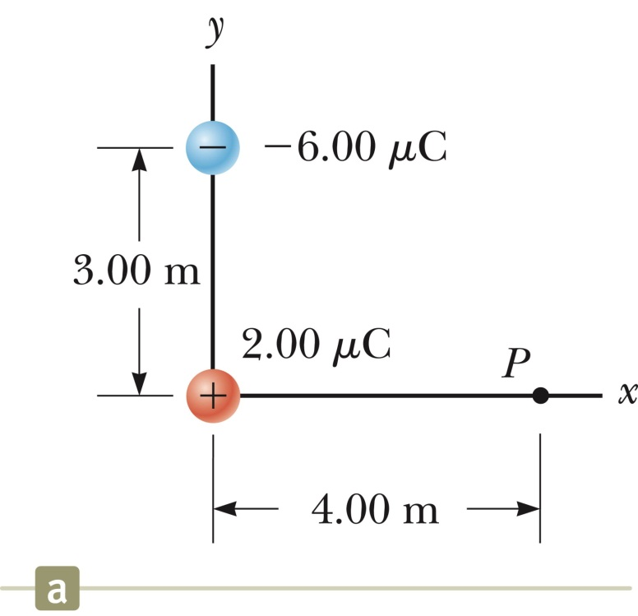
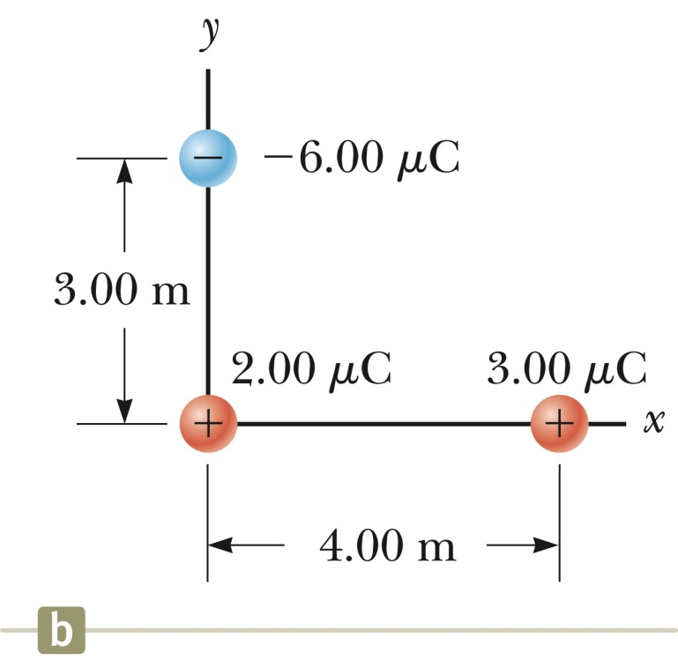
Potential and electric potential energy of multiple point charges
White board example:
Find the total electric potential, V, at point P, due the two charges in Figure (a).
What is the change in electric potential energy, U_{e}, as the third charge (Figure (b)) is moved from infinity to point, P?
Notes:
Warmup06 q1 and q2 and q3. Note summing absoulte values of kq/r^2 which is positive.
Plot V vs r for +/-q,

Slide 16
i-clicker
Two test charges are brought separately into the vicinity of a charge +Q. First, test charge +q is brought to point A, a distance r from +Q. Next, +q is removed and a test charge +2q is brought to point B a distance 2r from +Q.
Evaluate the electrostatic potential due to charge Q at point A and at point B. Is it greater at point A or is it greater at point B?
Potential at B is greater
Potential at B is smaller.
Potential at A and B are the same.
Extra: What is the energy required to move charge +q from infinity to point A
and charge +2q to from infinity to point B?
Notes:
Do same with potential energy

Slide 17
i-clicker
Two test charges are brought separately into the vicinity of a charge +Q. First, test charge +q is brought to a point a distance r from +Q. Then this charge is removed and test charge –q is brought to the same point. The electrostatic potential energy of which configuration is greater? (Hint: Sign matters!)
+ Q and +q
+Q and –q
It is the same for both.

Slide 18
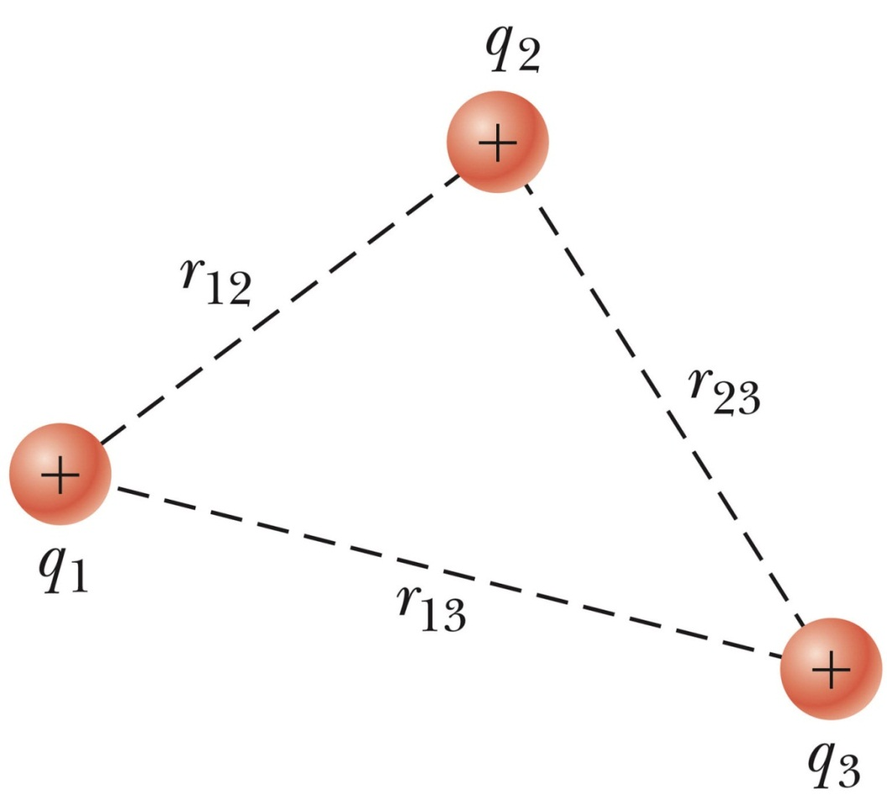
Electric potential energy of a system of charges
What is the electric potential energy, U_{e}, of this charge assembly?
What is the work required (by an outside agent) to assemble this charge?
What is the work done by the electric force when assembling this charge?
Notes:
Warmup06 q1 and q2 and q3. Note summing absoulte values of kq/r^2 which is positive.
Plot V vs r for +/-q,

Slide 19
Getting Electric Field from Potential
To go from electric field, E, to potential, V, we integrate
Can we go from potential to electric field?
These are partial derivatives – e.g. a derivative that treats y and z as constants while treating x as a variable, etc.
Notes:
E is rate of change of V per unit distance.
Do simple example, V = 3y (constant field) at end

Slide 20
White board example
Over a certain region of space, the electric potential is
V =$(\frac{5}{m}x−\frac{3}{m^{3}}x^{2}y+\frac{2}{m^{3}}{yz}^{2})$ V.
Find the expressions for the x, y, and z components of the electric field over this region.
What is the magnitude of the electric field at point P, which has coordinates (1.00, 0, -2.00) m?
Note: This potential and electric field are hard to visualize, this is just a number example to point out that the E-field is the – derivative (– gradient) of the el. potential, V.
Notes:
Do example E = 3y first.

Slide 21
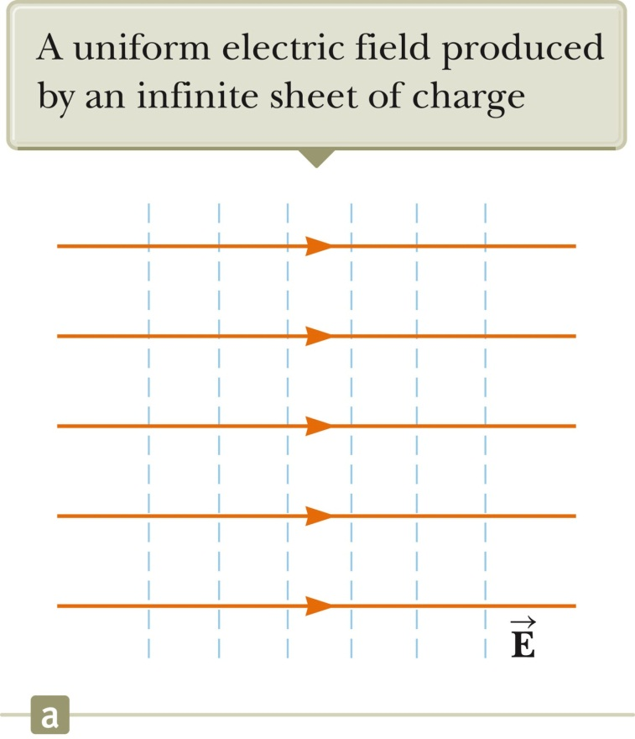
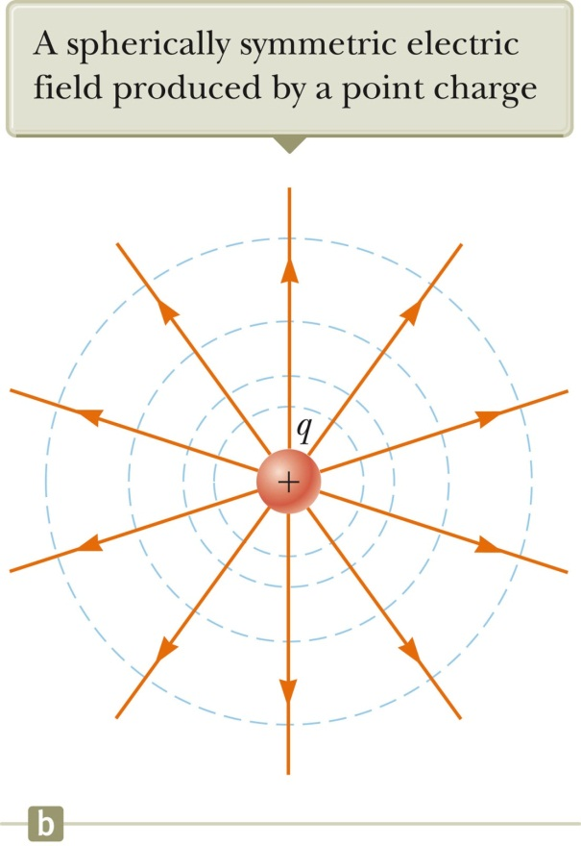
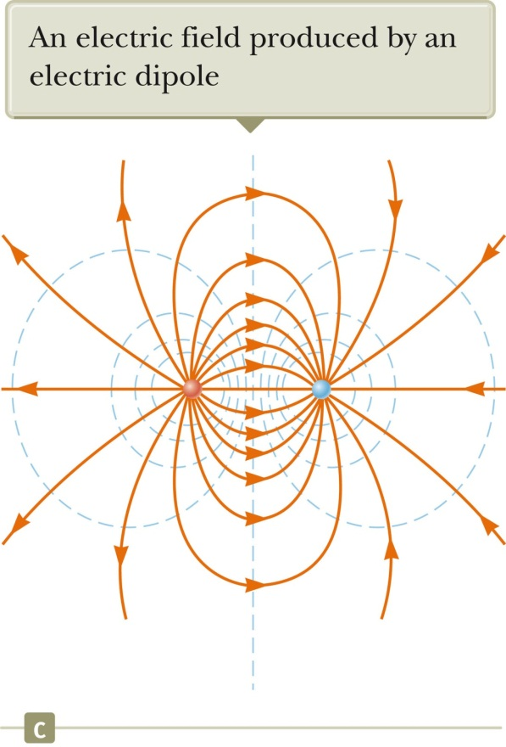
Equipotential Lines
Equipotential lines are perpendicular to field lines
→ Visualization of E-field and el. potential
When a test charge moves along an equipotential line (E, ds perpendicular), dV = 0 → equipotential lines are perpendicular to E-field.

Slide 22
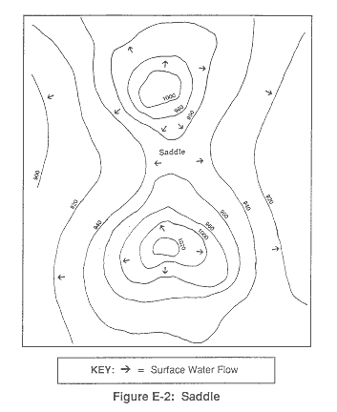
Equipotential Lines Are Like Topographical Maps
→ The electric field is minus the gradient (slope) of the potential
Regions of high potential are like “mountains”
For positive charges, they have a lot of energy there
Regions of low potential are like “valleys”
For positive charges, they have minimum energy there
Electric fields point down the slope
Closely spaced equipotential lines means big electric field

Slide 23
Equipotential Lines
i-clicker
In the graph below, what type of charge is at X, and what type is at Y?
Positive, both places
B) Positive at X, negative at Y
Negative at X, positive at Y
D) Negative, both places
potentials in kV
-1
+1
0
-2
+2
-3
Y
X
-4
+4
+3

Slide 24
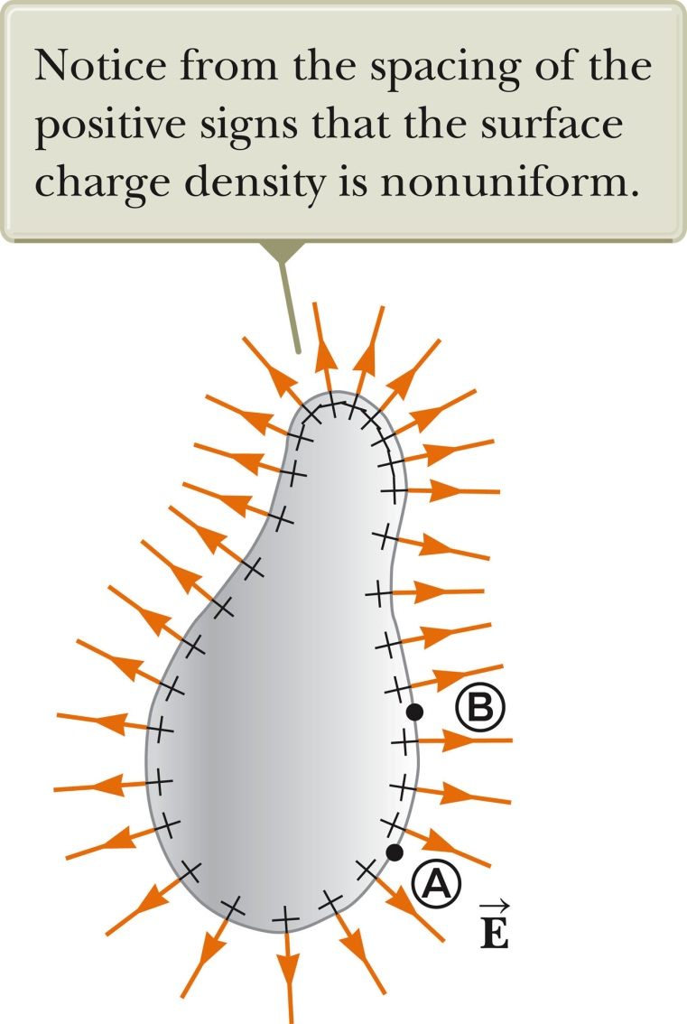
Electric Potential due to a Charged Conductor
From Chapter 24: Charges in a conductor are mobile. Thus, for a conductor at electrostatic equilibrium (when charges are not moving any longer) the following is true:
The electric field inside a good (hollow or solid) conductor is zero.
Any net charge on a good conductor distributes itself on the surface.
The electric field is always perpendicular to the surface outside of a conductor and the magnitude right outside is E = σ/ε₀.
Show now:
Potential, V, inside/on a conductor is constant.
On irregular shaped objects, electric field is strongest at sharp points; charges accumulate on location with smallest radius of curvature (sharp points).

Slide 25
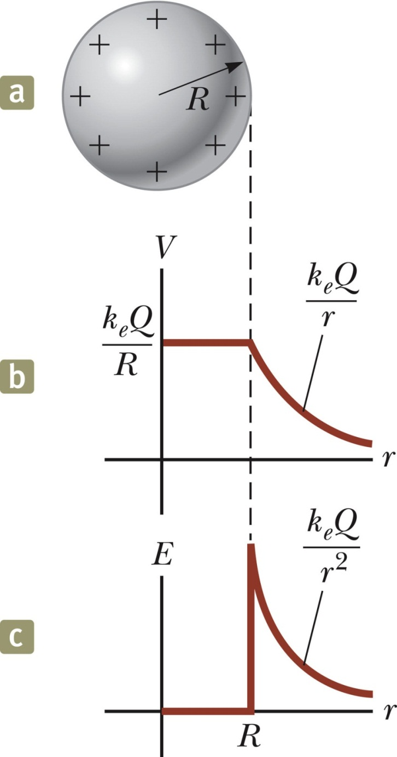
Potential and Electric Field of a Conducting Sphere
Given a charge q on a conducting sphere of radius, R, what is the potential everywhere?
Outside the sphere, the electric field is the same as for a point charge
Therefore, so is the potential, V.
Inside, the potential is constant
It must be continuous at the boundary
Notes:
Do simple problem. Metal sphere with charge 2 microcoulombs and radius of 2 m. What is potential and E at 1 m and 3 m?

Slide 26
Charges on conductors accumulate at points (small sphere)
White board example.
Two widely separated conducting spheres, of radii R₁ = 1.00 cm and R₂ = 2.00 cm, each have 6.00 nC of charge put on them.
What is their potential (on surface and inside)?
They are then joined by an electrical wire.
How much charge do they each end up with (ignore charge on wire)?
What is the final potential?
Where is the strongest electric field (and highest charge density)?
q₁
q₂
Notes:
Warmup 07 q1, q2, q3

Slide 27
Electric Fields near conductors
q₁
q₂
The potential for the two spheres ended up the same:
The electric fields at the surface are not the same:
→ The more curved the surface is, the higher the electric field is there
Very strong electric field, E, here
Very high charge density, σ, here
A sharp point can cause charged particles to spontaneously be shed into air, even though we normally think of air as an insulator [ionize air]
Called “Corona discharge”

Slide 28
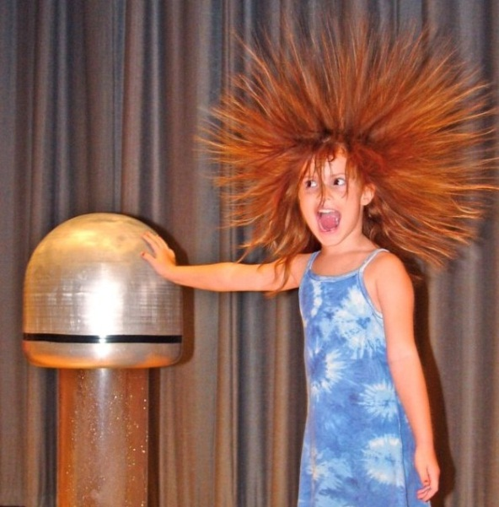
The Van de Graaff Generator
Hollow conducting sphere, insulating belt, source of electric charge.
Source causes charge to move to the belt.
Belt rotates up inside sphere.
Charge jumps to conductor inside sphere.
Charge moves to outside of sphere.
Since all the charge is on the outside of the sphere, process can be repeated indefinitely.
-
→ Can get a lot of charge on the dome.
Extremely high charge density
Extremely high E-fields.

Slide 29
Review:
Charges create an electric field. We mostly dealt with point charges, spheres, planes (and cylinders).
When a positive test charge q₀ is moved between points A and B in an electric field the change in potential energy of the charge-field system is
The potential difference between points A and B in an electric field:
Special cases:
Potential difference in a uniform electric field (two plates) is
Potential around a point charge (with V = ∞ at infinity)
Potential of multiple point charges
The potential energy (assembly work needed) associated with a pair of point charges
Electric field is gradient of potential. If the electric potential is known as a function of x, y, z,, we can obtain the x-, y- z-component of the field by
Equipotential lines, understand, are perpendicular to E-field
Properties of a conductor

Slide 30
Extra slides

Slide 31
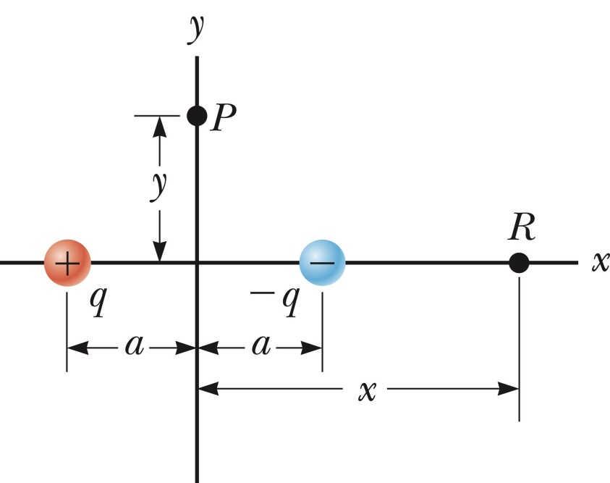
Electric potential of a dipole
White board example
An electric dipole consists of two charges of equal magnitude and opposite sign, separated by a distance, 2a (see figure).
Calculate the electric potential at point P on the y-axis.
Calculate the electric potential at point R on the x-axis.
What is V and E_{x} on the x-axis far from the dipole (x>>a)?

Slide 32
Getting Electric Field from Potential (2)
Fancy notation: Mathematically, it is useful to define the operator
When this derivative operator is used this way (to make a vector out of a scalar) it is called a gradient
“The electric field is minus the gradient of the potential”
“The electric field is minus the slope of the potential”
Yellow boxes mean a more mathematically sophisticated way to write the same thing. You don’t need to know or use it if you don’t want to.

Slide 33
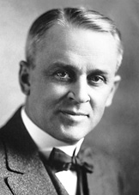
The Millikan Oil Drop experiment
→ Determination of fundamental charge $e=1.6∙{10}^{−19}C$
Atomizer produced tiny drops of oil; gravity pulls them down
Atomizer also induces small charges
Electric field opposes gravity
If electric field is right, drop stops falling
Millikan showed that you always got integer multiples of a simple fundamental charge
Nobel Prize, 1923
i-clicker
What would happen if the drop started with charge -2e, but it suddenly picked up another electron?
A) It would start moving downwards
B) It would start moving upwards
C) Since it gained BOTH mass and charge, no effect
-

